Slide 1
Presenter notes
Resources:
GitHub Apps
GitHub Actions
GitHub Webhooks and events
Octokit libraries
Probot
GitHub ToolKit for GitHub Actions
JavaScript action template
Container action template
GitHub Marketplace filterable by Apps or Actions
Demo prep:
UI walkthrough – generating a personal access token
UI walkthrough – Generating an Oauth token
FAQ:
On several slides, between sections
Customer stories:
N/A
Expected timing:
N/A

Slide 2
GitHub apps

Slide 3
This module will enable you to:
Discuss and describe different applications and functionalities of GitHub apps

Slide 4


GitHub app vs GitHub Actions
GitHub apps
Acts across multiple repos, or at the organization level
Available to the public but no part of the code is public
Requires:
User interaction
Handled state
Permissions that are outside the set provided by Actions
Events that are outside the set provided by Actions
Hosting
GitHub Actions
Essentially “headless,” i.e. it does not require user interaction or uses GitHub for its user interface
Integration does not need to persist data in a database
Wraps an existing CLI, or API
Comfort with your action code being (publicly) visible
Prefer GitHub to run your integration
Notes:
Take a break before continuing? Set an 5 minute timer.

Slide 5
Endpoints available for GitHub apps
activity
apps
checks
codes-of-conduct
emojis
git
gitignore
issues
licenses
markdown
meta
orgs
projects
pulls
rate-limit
reactions
repos
search
teams
users
https://docs.github.com/rest/overview/endpoints-available-for-github-apps
Notes:
We have looked at how to interact with the API via REST or GraphQL, but what are the endpoints that you can interact with?
Note that some endpoints work with GitHub Apps and some don’t for security reasons
https://docs.github.com/rest/overview/endpoints-available-for-github-apps

Slide 6
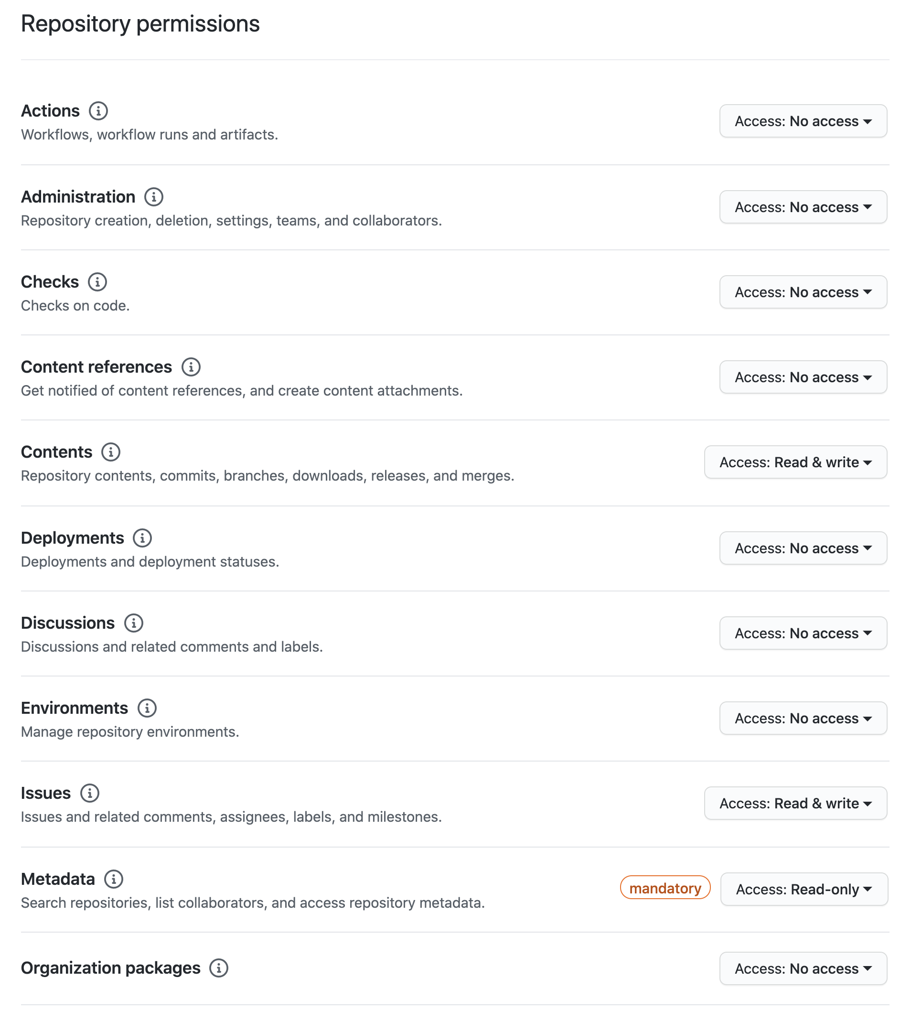
Granular GitHub app permissions

Slide 7
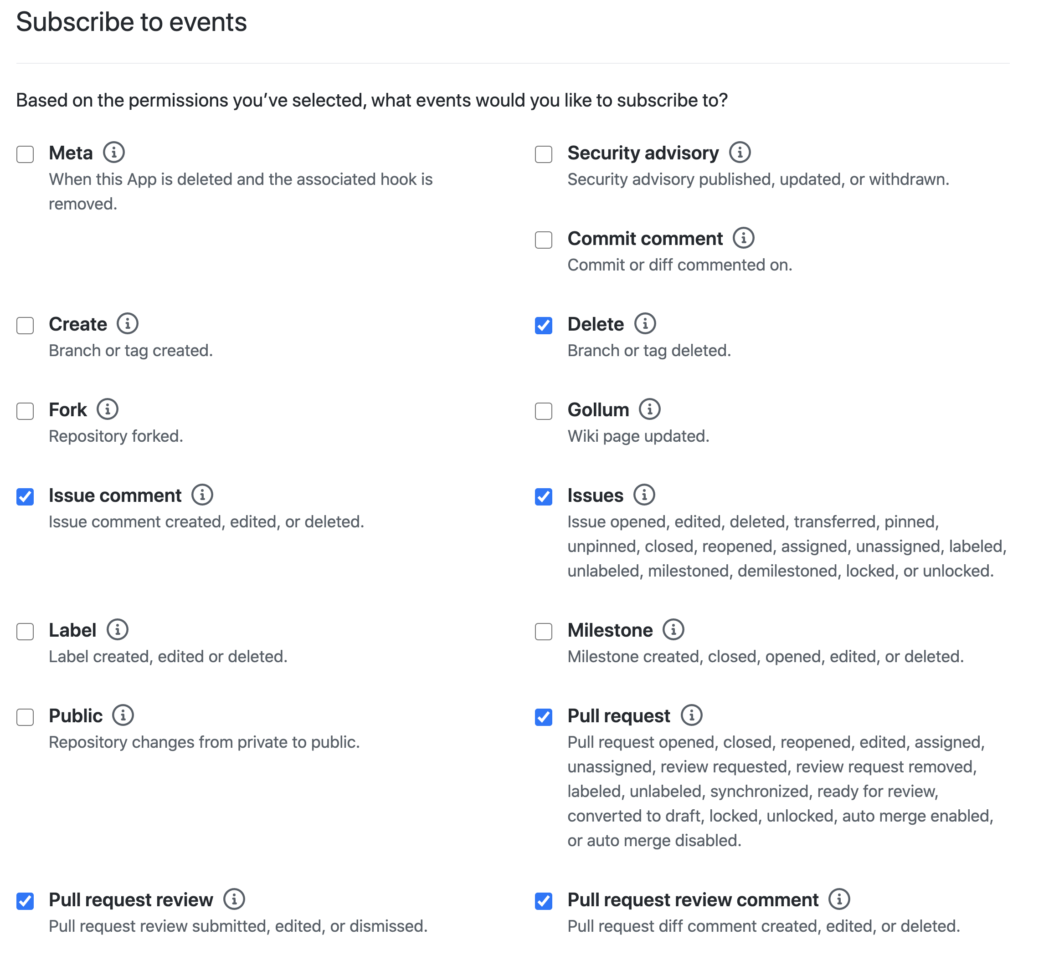
Event subscription

Slide 8
GitHub Action
permissions
Permission | Access | Forked repos access
actions | read/write | read
checks | read/write | read
contents | read/write | read
deployments | read/write | read
issues | read/write | read
metadata | read | read
packages | read/write | read
pull requests | read/write | read
repository projects | read/write | read
statuses | read/write | read
Notes:
Actions have different endpoints available compared to GitHub Apps

Slide 9
Webhooks and events
GitHub Apps
50 webhook events and growing
check_run, check_suite, code_scanning_alert, commit_comment, content_reference, create, delete, deploy_key, deployment, deployment_status, fork, github_app_authorization, gollum, installation, installation_repositories, issue_comment, issues, label, marketplace_purchase, member, membership, meta, milestone, organization, org_block, package, page_build, ping, project_card, project_column, project, public, pull_request, pull_request_review, pull_request_review_comment, push, release, repository_dispatch, repository, repository_import, repository_vulnerability_alert, security_advisory, sponsorship, star, status, team, team_add, watch, workflow_dispatch, workflow_run
GitHub Actions
27 webhook events*
check_run, check_suite, create, delete, deployment, deployment_status, fork, gollum, issue_comment, issues, label, milestone, page_build, project, project_card, project_column, public, pull_request, pull_request_review, pull_request_review_comment, pull_request_target, push, registry_package, release, status, watch, workflow_run
2 manual events
workflow_dispatch, repository_dispatch
1 scheduled event
schedule
Notes:
Think of this as a comparison of what can trigger your app or action

Slide 10
Host apps and Actions
GitHub Apps
Your own “webserver”
Serverless
AWS Lambda
Azure Functions
GCP Serverless
Vercel
GitHub Actions
Runs on GitHub hosted runners
Runs on self-hosted runners
Open source: https://github.com/actions/runner
Create your own custom runner with whatever customizations you need (more hardware, OS, on-prem, in cloud, etc)
Free to use with GitHub Actions, but you're responsible for cost of maintaining your runner machines
GitHub recommends against using self-hosted runners for public repos.

Slide 11
Apps and Actions
Follow best practices for integrators
Adhere to rate limits
Use pagination
Use Octokit plugins
Understand GraphQL resource limitations and query costs

Slide 12
Questions

